Slide 1
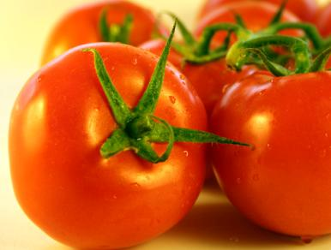
TOMATO
By: Varga Boglárka

Slide 2
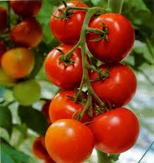
Tomato
he word "tomato" may refer to the plant or the edible, typically red, fruit which it bears. Originating in South America, the tomato was spread around the world following the Spanish colonization of the Americas, and its many varieties are now widely grown, often in greenhouses in cooler climates.The tomato fruit is consumed in diverse ways, including raw, as an ingredient in many dishes and sauces, and in drinks. While it is botanically a fruit, it is considered a vegetable for culinary purposes, which has caused some confusion. The fruit is rich in lycopene, which may have beneficial health effects.The tomato belongs to the nightshade family. The plants typically grow to 1–3 metres in height and have a weak stem that often sprawls over the ground and vines over other plants. It is a perennial in its native habitat, although often grown outdoors in temperate climates as an annual.

Slide 3
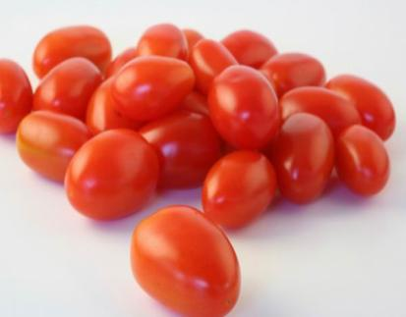
History
The tomato is native to South America. Genetic evidence shows the progenitors of tomatoes were herbaceous green plants with small green fruit and a center of diversity in the highlands of Peru. One species, Solanum lycopersicum, was transported to Mexico, where it was grown and consumed by Mesoamerican civilizations. The exact date of domestication is not known. The first domesticated tomato may have been a little yellow fruit, similar in size to a cherry tomato, grown by the Aztecs of Central Mexico. The word "tomato" comes from the Nahuatl word tomatl, literally "the swelling fruit".Spanish explorer Cortés may have been the first to transfer the small yellow tomato to Europe after he captured the Aztec city of Tenochtítlan, now Mexico City, in 1521, although Christopher Columbus, a Genoese working for the Spanish monarchy, may have taken them back as early as 1493.
The earliest discussion of the tomato in European literature appeared in an herbal written in 1544 by Pietro Andrea Mattioli, an Italian physician and botanist, who named it pomo d’oro, or "golden apple".Aztecs and other peoples in the region used the fruit in their cooking; it was cultivated in southern Mexico and probably other areas by 500 BC. The Pueblo people are thought to have believed that those who witnessed the ingestion of tomato seeds were blessed with powers of divination.The large, lumpy tomato, a mutation from a smoother, smaller fruit, originated in Mesoamerica, and may be the direct ancestor of some modern cultivated tomatoes.

Slide 4
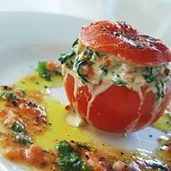
Ingredients:
8 large beef tomatoes
handful of dried porcini
olive oil, for frying
Two 250g packs spinach
8 flat mushrooms, sliced into rough cubes
300 ml vegetable or chicken stock
2 cloves garlic, finely chopped
2 sprig thyme, stalks removed, leaves finely chopped
01 lemon, juice only
100 g cottage cheese or ricotta cheese
60 g parmesan, freshly grated
good pinch of freshly grated nutmeg
1 egg yolk, beaten
black pepper
For the dressing:
1/2 tsp French mustard
2 tbsp white wine vinegar
6 tbsp olive oil
small handful basil
Stuffed tomatoes with mushrooms

Slide 5
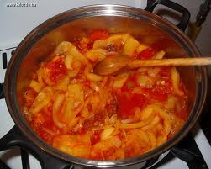
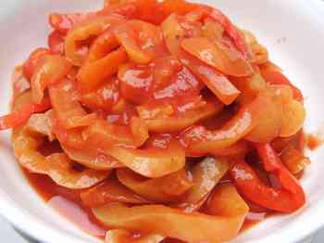
LECSÓ
Recipe:
Ingredients:
-2 tablespoons bacon grease or oil
-1 medium onion, sliced thinly
-1 pound banana or Italian or green bell peppers. cut into 1/4-inch strips
-3 large very ripe tomatoes, peeled and chopped or use SHORTCUT
-1 1/2 teaspoons sugar
-1 1/2 teaspoons salt (less if using sausage)
-1 tablespoon sweet Hungarian paprika
Preparation:
In a large skillet, saute the onion in bacon fat or oil over low heat for 5 minutes. Add pepper and cook another 15 minutes. Add tomatoes, sugar, salt and paprika and cook for another 25-30 minutes, stirring occasionally, or until mixture resembles chunky tomato sauc.

Slide 6
Condensed Tomato
Ketchup

